Slide 1

Academic Year 2025 - 26 S6 MINI PROJECT - II Final Review
PROJECT TITLE
TRAINING RECOMMENDATION SYSTEM
BIP PROJECT ID
2026MIN1437
CATERGORY
INTERNAL
BATCH MEMBER
MONIKA N (7376232AD196)
GUIDE
Mr. NAVANEETH KUMAR K
ASSISTANT PROFESSOR III
DEPARTMENT OF ARTIFICIAL INTELLIGENCE AND DATA SCIENCE

Slide 2
AIM & OBJECTIVES OF THE PROJECT (Problem Statement)
The aim of this project is to develop a Training Recommendation System that provides personalized learning guidance for students and enables trainers to efficiently monitor and evaluate student progress.
In many existing learning environments, students often lack structured guidance and personalized study plans, while trainers face difficulties in tracking individual performance and progress effectively. .
The system also includes an OCR module to extract and simplify text from images, along with a self-evaluation MCQ test section for assessing knowledge and performance. Additionally, students can manage their profiles, and trainers are provided with tools to track student progress, marks, and overall performance.
The application is developed using HTML, CSS, and JavaScript for the frontend, Python Flask for the backend, and MySQL for database management, ensuring a complete and user-friendly solution.

Slide 3
LITERATURE SURVEY
Sl.No. | Journal Paper Title with Author | Works carried out ( with details of Methods/ Materials/ Software/ Algorithms / fabrication / techniques/ components used ) | Information gathered relevant to your project
1 | J. Smith and A. Kumar, “Personalized Learning Systems Using Machine Learning,” IEEE Transactions on Education, vol. 62, no. 4, pp. 300–308, 2019. | Used machine learning algorithms to recommend personalized learning paths based on student behavior and performance data. | Helped in designing a system that suggests customized learning roadmaps for students.
2 | R. Patel et al., “Web-Based Student Monitoring System,” International Journal of Computer Applications, vol. 180, no. 12, 2018. | Developed a web application to track student progress, attendance, and performance. | Provided ideas for trainer dashboard and progress tracking features
3 | M. Brown and L. Davis, “Secure Authentication Using JWT,” IEEE Security & Privacy, vol. 17, no. 3, pp. 45–52, 2020. | Implemented JWT-based authentication for secure login systems. | Used for implementing secure login and session management in the project.
4 | S. Lee, “Optical Character Recognition Techniques for Text Extraction,” Pattern Recognition Journal, vol. 95, pp. 20–30, 2019. | Explored OCR algorithms for extracting text from images. | Helped in integrating OCR module for extracting and displaying text.
5 | K. Sharma and P. Gupta, “Online Quiz Systems for Student Evaluation,” International Journal of Education Technology, 2021. | Developed MCQ-based testing system with automatic scoring. | Used for designing self-evaluation quiz feature.

Slide 4
LITERATURE SURVEY
Sl.No. | References ( Journal Papers Only) | Works carried out ( with details of Methods/ Materials/ Software/ Algorithms / fabrication / techniques/ components used ) | Information gathered relevant to your project
6 | T. Anderson, “Flask-Based Web Application Development,” Journal of Web Engineering, vol. 15, no. 2, 2018. | Explained backend development using Flask framework and REST APIs. | Guided backend implementation and API routing.
7 | D. Wilson et al., “Database Design Using MySQL for Web Applications,” International Journal of Database Systems, 2019 | Discussed relational database design and data management. | Helped in structuring user data, profiles, and results storage.
8 | A. Roy, “User Interface Design for Educational Platforms,” Human-Computer Interaction Journal, 2020. | Focused on UI/UX principles for student-friendly dashboards. | Used to design simple and user-friendly interface.
9 | P. Singh and R. Mehta, “E-Learning Systems with Personalized Recommendations,” IEEE Access, vol. 8, pp. 150000–150010, 2020. | Used recommendation techniques to improve learning efficiency. | Inspired personalized course and roadmap generation.
10 | L. Chen, “REST API Testing Using Postman,” Software Testing Journal, 2021. | Demonstrated API testing and debugging techniques | Helped in testing backend APIs effectively using Postman.

Slide 5
SCOPE OF THE PROJECT
SYSTEM PURPOSE: The project aims to develop a web-based Training Recommendation System that provides personalized learning guidance and supports trainers in monitoring student progress.
USER MANAGEMENT & SECURITY: The system includes secure login and registration with password hashing and JWT authentication, along with student profile management.
STUDENT FEATURES: Students are provided with a dashboard displaying course details, learning goals, daily roadmap generation, MCQ-based self-evaluation, and an OCR module for text extraction.
TRAINER FEATURES: Trainers can monitor student progress, track marks, and analyze overall performance effectively.
TECHNOLOGY SCOPE: The application is developed using HTML, CSS, and JavaScript for the frontend, Python Flask for the backend, and MySQL for database management.

Slide 6
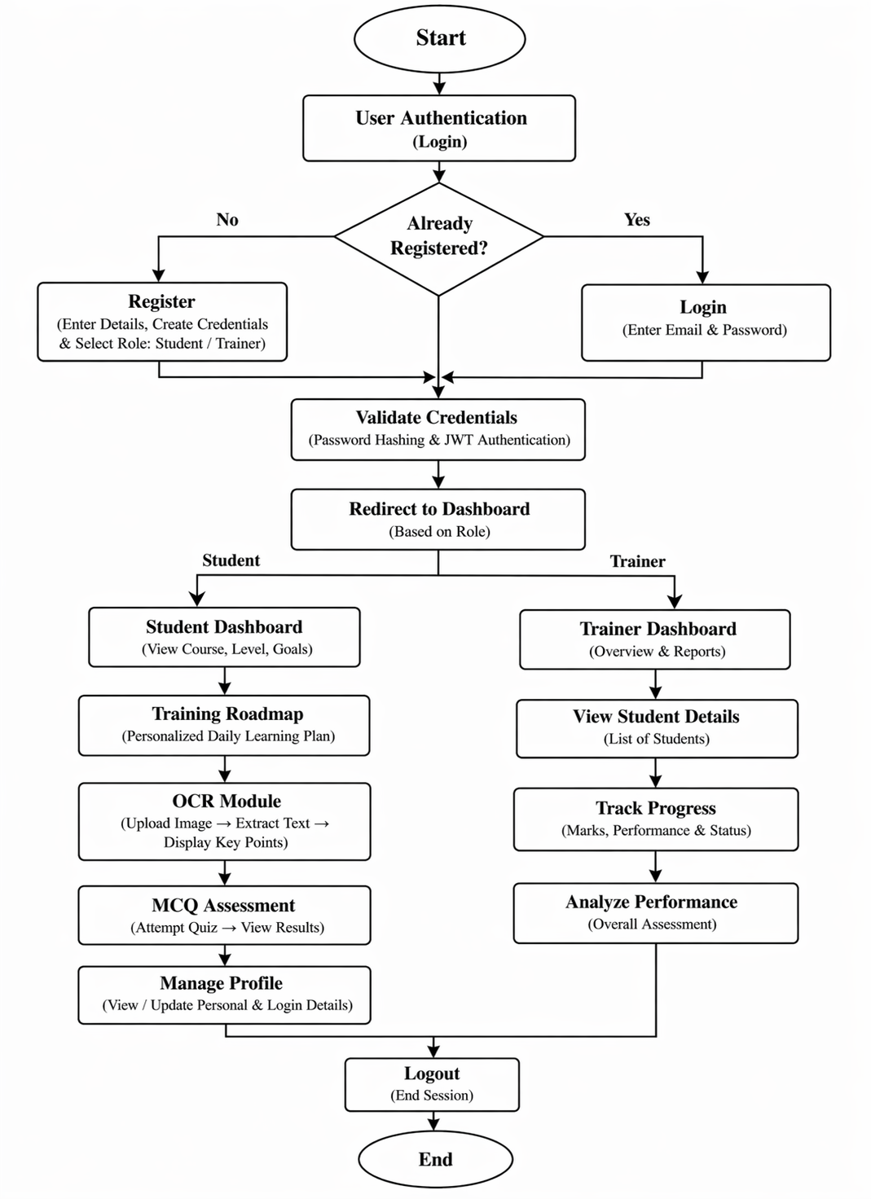
PROPOSED METHODOLOGY ( Flow Chart)

Slide 7
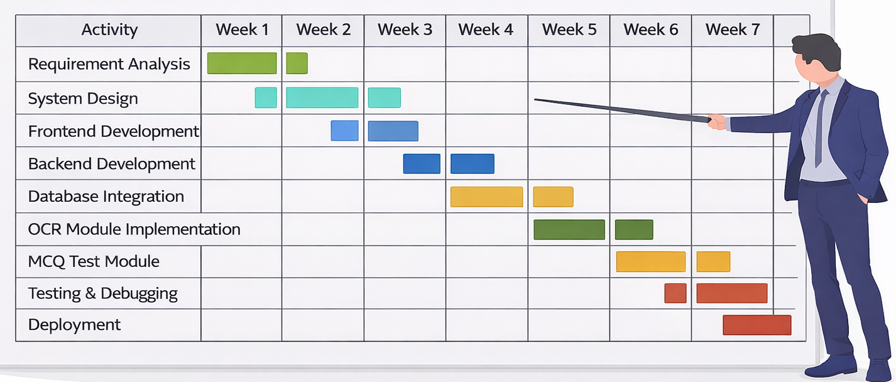
PROPOSED METHODOLOGY ( Gantt Chart)

Slide 8
CHOICE OF COMPONENTS / MODULES / METHODS/TECHNIQUES EQUIPMENT USED FOR PROJECT DEVELOPMENT
MODULES : The system is divided into key modules including Login & Registration, Student Dashboard, Trainer Dashboard, OCR Module, MCQ Test Module, and Performance Tracking Module for organized development.
METHODS : The project implements techniques such as JWT-based authentication for security, password hashing for safe credential storage, OCR for text extraction from images, and REST API architecture for communication between frontend and backend.
TECHNOLOGIES USED : The project is developed using frontend technologies such as HTML, CSS, and JavaScript for building the user interface, along with Python Flask as the backend framework for handling server-side logic and API development. MySQL is used as the database for storing user data, performance records, and system information. Additionally, JWT is implemented for secure authentication, OCR technology is used for text extraction from images, and Postman is used for testing and validating API endpoints.

Slide 9
DESIGN(S) (HARDWARE / SOFTWARE ARCHITECTURE)
ARCHITECTURE TYPE: The project follows a three-tier architecture to ensure better organization, scalability, and efficient data management.
PRESENTATION LAYER: The presentation layer is developed using HTML, CSS, and JavaScript to provide an interactive and user-friendly interface for users.
APPLICATION LAYER: The application layer is built using Python Flask, which handles business logic, user authentication using JWT, and API communication between frontend and backend.
DATABASE LAYER: The database layer uses MySQL to store user information, course details, and performance records securely.
ADDITIONAL MODULES: The system integrates JWT for secure authentication, OCR for text extraction from images, and an MCQ module for conducting self-evaluation tests.

Slide 10
ANALYSIS OF RESULTS AND DISCUSSION
SYSTEM PERFORMANCE: The system successfully performs all core functionalities including user authentication, dashboard access, and module operations without major errors.
USER EXPERIENCE: The interface is simple and user-friendly, allowing students and trainers to easily navigate through dashboards and features.
STUDENT OUTCOMES: Students are able to follow personalized learning roadmaps, use OCR for better understanding, and improve their knowledge through MCQ assessments.
TRAINER EFFICIENCY: Trainers can effectively monitor student progress, track marks, and analyze overall performance in a structured manner.
ACCURACY AND RELIABILITY: The system provides accurate results in authentication, quiz evaluation, and data storage, ensuring reliable performance.

Slide 11
CONCLUSION
The Training Recommendation System is successfully developed as a web-based application that provides personalized learning support for students and efficient monitoring tools for trainers.
The project achieves its objectives by implementing secure authentication, role-based dashboards, OCR functionality, and MCQ-based self-evaluation. It enhances learning efficiency by offering structured daily roadmaps and enables trainers to effectively track and analyze student performance.
The use of technologies such as HTML, CSS, JavaScript, Flask, and MySQL ensures that the system is reliable, scalable, and user-friendly. Overall, the project presents a practical solution for improving digital learning and performance tracking, with future scope for enhancements like AI-based recommendations, mobile application support, and advanced analytics features.

Slide 12
FUTURE ENHANCEMENTS
AI-BASED RECOMMENDATIONS: The system can be enhanced by integrating artificial intelligence to provide more accurate and personalized learning suggestions based on student performance and behavior.
MOBILE APPLICATION SUPPORT: A mobile version of the application can be developed to allow users to access the system anytime and anywhere.
ADVANCED ANALYTICS: The system can include advanced analytics and visualization tools to provide deeper insights into student progress and performance
Enhanced OCR Capabilities: The OCR module can be improved to support multiple languages and provide more accurate text extraction.

Slide 13
REFERENCES ( Journal Papers/ Books / Website in IEEE Format )
Journal
Books
Ian Goodfellow, Yoshua Bengio, and Aaron Courville, Deep Learning, MIT Press, 2016.
Patent
Johnson, “System and Method for Personalized Learning Recommendation,” U.S. Patent No. US10234567B2, 2019.
Website
J. Smith and A. Kumar, “Personalized Learning Systems Using Machine Learning,” IEEE Transactions on Education, 2019.
R.Patel et al., “Web-Based Student Monitoring System,” International Journal of Computer Applications, 2018.
Python Flask Official Documentation: https://flask.palletsprojects.com/
MySQL Official Documentation: https://dev.mysql.com/doc/

